Slide 1

FPT University
Android programMing
Lesson 10
Version 1.0

Slide 2
Agenda
Android Intents
Explicit Intents
Implicit Intents
Broadcast Intents and Broadcast Receivers

Slide 3
Android Intents
Overview of Intents
Intents (android.content.Intent) are the messaging system by which one activity is able to launch another activity
Intents also allow for the transfer of data from the sending activity to the receiving activity

Slide 4
Explicit Intents
An explicit intent requests the launch of a specific activity by referencing the component name
Intent i = new Intent(this, ActivityB.class); startActivity(i);

Slide 5
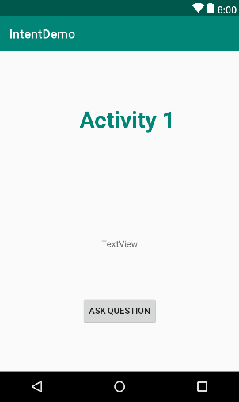
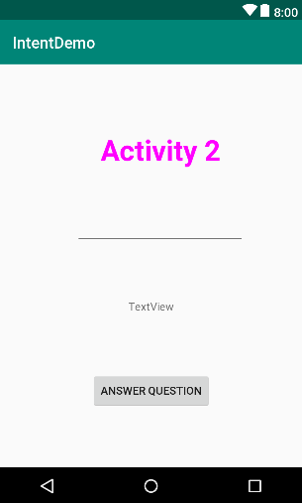
Explicit Intents
Creating the Explicit Intent Application

Slide 6
Explicit Intents
Creating the Intent
public void onClick(View view) { Intent intent = new Intent(this, Main2Activity.class); EditText editText = findViewById(R.id.editText); String text = editText.getText().toString(); intent.putExtra("textString", text); startActivity(intent); }

Slide 7
Explicit Intents
Extracting Intent Data
@Override protected void onCreate(Bundle savedInstanceState) { super.onCreate(savedInstanceState); setContentView(R.layout.activity_main2); Bundle bundle = getIntent().getExtras(); if(bundle==null){ return; } String text = bundle.getString("textString"); EditText editText2 = findViewById(R.id.editText2); editText2.setText(text); }
Notes:
// send where details is object
ClassName details = new ClassName();
Intent i = new Intent(context, EditActivity.class);
i.putExtra("Editing", details);
startActivity(i);
//receive
ClassName model = (ClassName) getIntent().getSerializableExtra("Editing");
And
Class ClassName implements Serializable { }

Slide 8
Explicit Intents
Launching ActivityB as a Sub-Activity
private static final int REQUEST_CODE = 5; public void onClick(View view) { Intent intent = new Intent(this, Main2Activity.class); EditText editText = findViewById(R.id.editText); String text = editText.getText().toString(); intent.putExtra("textString", text); startActivityForResult(intent,REQUEST_CODE);s }

Slide 9
Explicit Intents
Get returned data from sub activity
@Override protected void onActivityResult(int requestCode, int resultCode, Intent data) { if ((requestCode == REQUEST_CODE)&&(resultCode == RESULT_OK)) { TextView textView = (TextView) findViewById(R.id.textView); String returnString = data.getExtras().getString("returnData"); textView.setText(returnString); } }

Slide 10
Explicit Intents
Return data to the main activity
public void onClick(View view) { finish(); }
@Override public void finish() { Intent data = new Intent(); EditText editText1 = (EditText) findViewById(R.id.editText2); String returnString = editText1.getText().toString(); data.putExtra("returnData", returnString); setResult(RESULT_OK, data); super.finish(); }

Slide 11
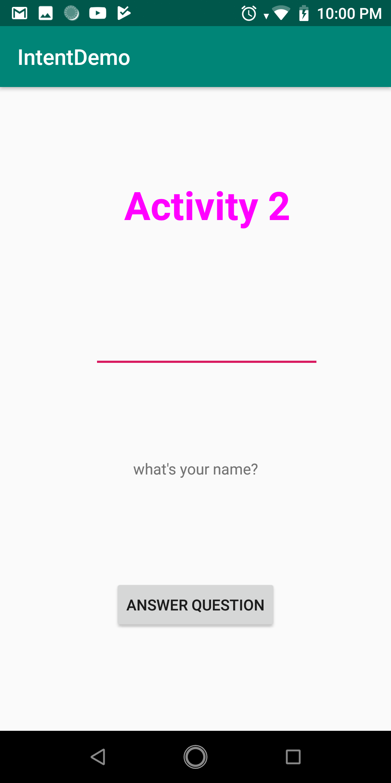
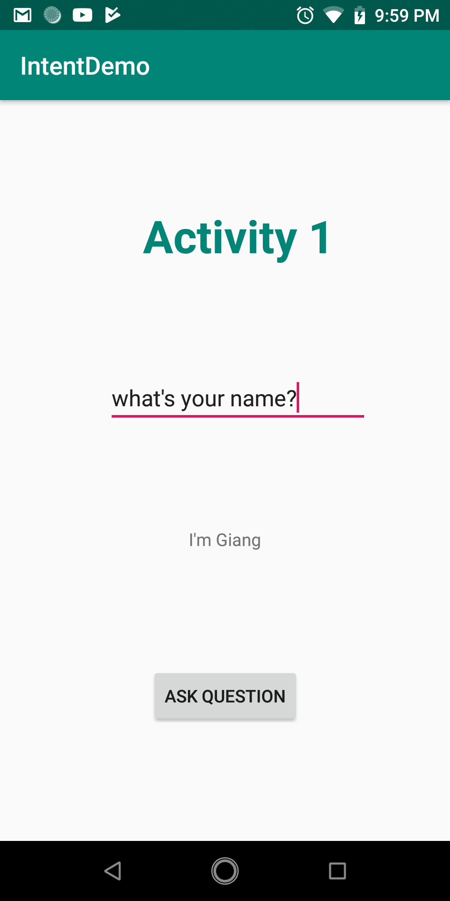
Explicit Intents
Testing application

Slide 12
Implicit Intents
Implicit intents identify the activity to be launched by specifying the action to be performed and the type of data to be handled by the receiving activity
Intent intent = new Intent(Intent.ACTION_VIEW, Uri.parse("http://www.google.com")); startActivity(intent);

Slide 13
Implicit Intents
Using Intent Filters
It is important to note that both the sending and receiving activities must have requested permission for the type of action to be performed.
<uses-permission android:name="android.permission.INTERNET" /> <application android:icon="@mipmap/ic_launcher" android:label="@string/app_name" > <activity android:label="@string/app_name" android:name=".WebViewActivity" > <intent-filter> <action android:name="android.intent.action.VIEW" /> <category android:name="android.intent.category.DEFAULT" /> <data android:scheme="http" /> </intent-filter> </activity> </application>

Slide 14
Implicit Intents
Checking Intent Availability
public static boolean isIntentAvailable(Context context, Intent intent) { final PackageManager packageManager =
context.getPackageManager(); List<ResolveInfo> list = packageManager.queryIntentActivities(intent, PackageManager.MATCH_DEFAULT_ONLY); return list.size() > 0; }
Notes:
It is generally unwise to assume that an activity will be available for a particular intent, especially since the absence of a matching action will typically result in the application crashing. Fortunately, it is possible to identify the availability of an activity for a specific intent before it is sent to the runtime system. The following method can be used to identify the availability of an activity for a specified intent action type:

Slide 15
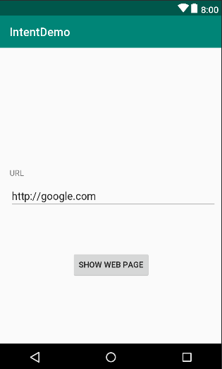
Implicit Intents
Creating the Android Studio Implicit Intent Example Project

Slide 16
Implicit Intents
Creating the Implicit Intent
public void showWebPage(View view) { EditText url = findViewById(R.id.editText); Intent intent = new Intent(Intent.ACTION_VIEW, Uri.parse(url.getText().toString())); startActivity(intent); }

Slide 17
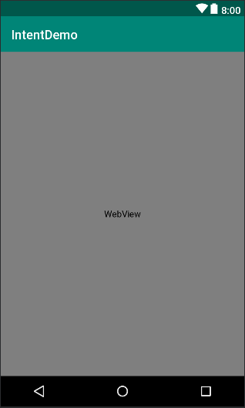
Implicit Intents
Adding a Second Matching Activity

Slide 18
Implicit Intents
Add intent filter and permission
<uses-permission android:name="android.permission.INTERNET" />
<activity android:name=".MyWebViewActivity"> <intent-filter tools:ignore="AppLinkUrlError"> <action android:name="android.intent.action.VIEW" /> <category android:name="android.intent.category.DEFAULT" /> <data android:scheme="http" /> </intent-filter> </activity>

Slide 19
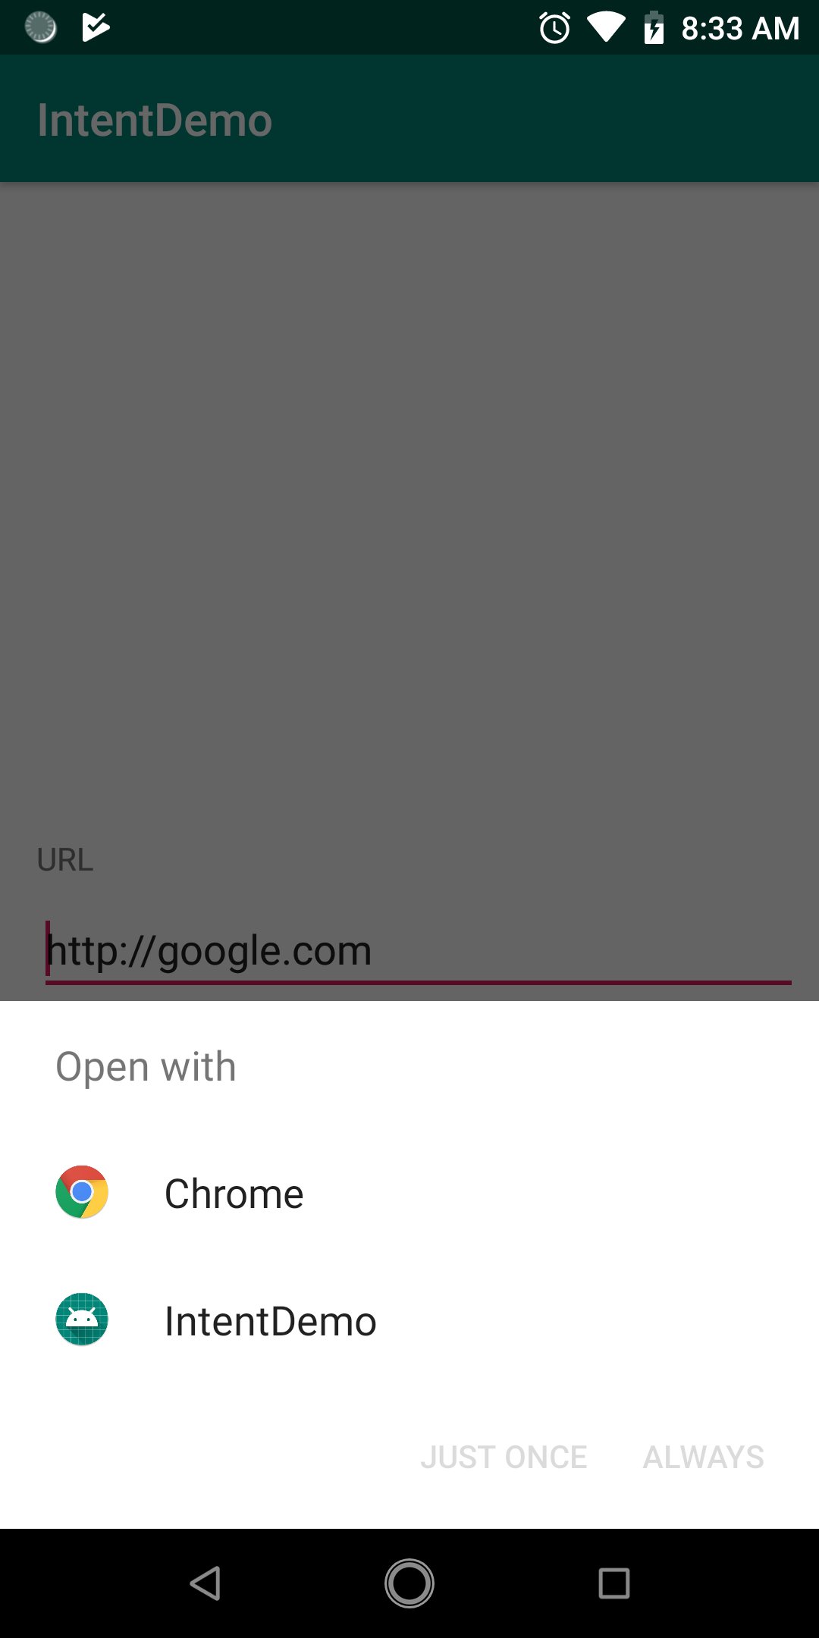
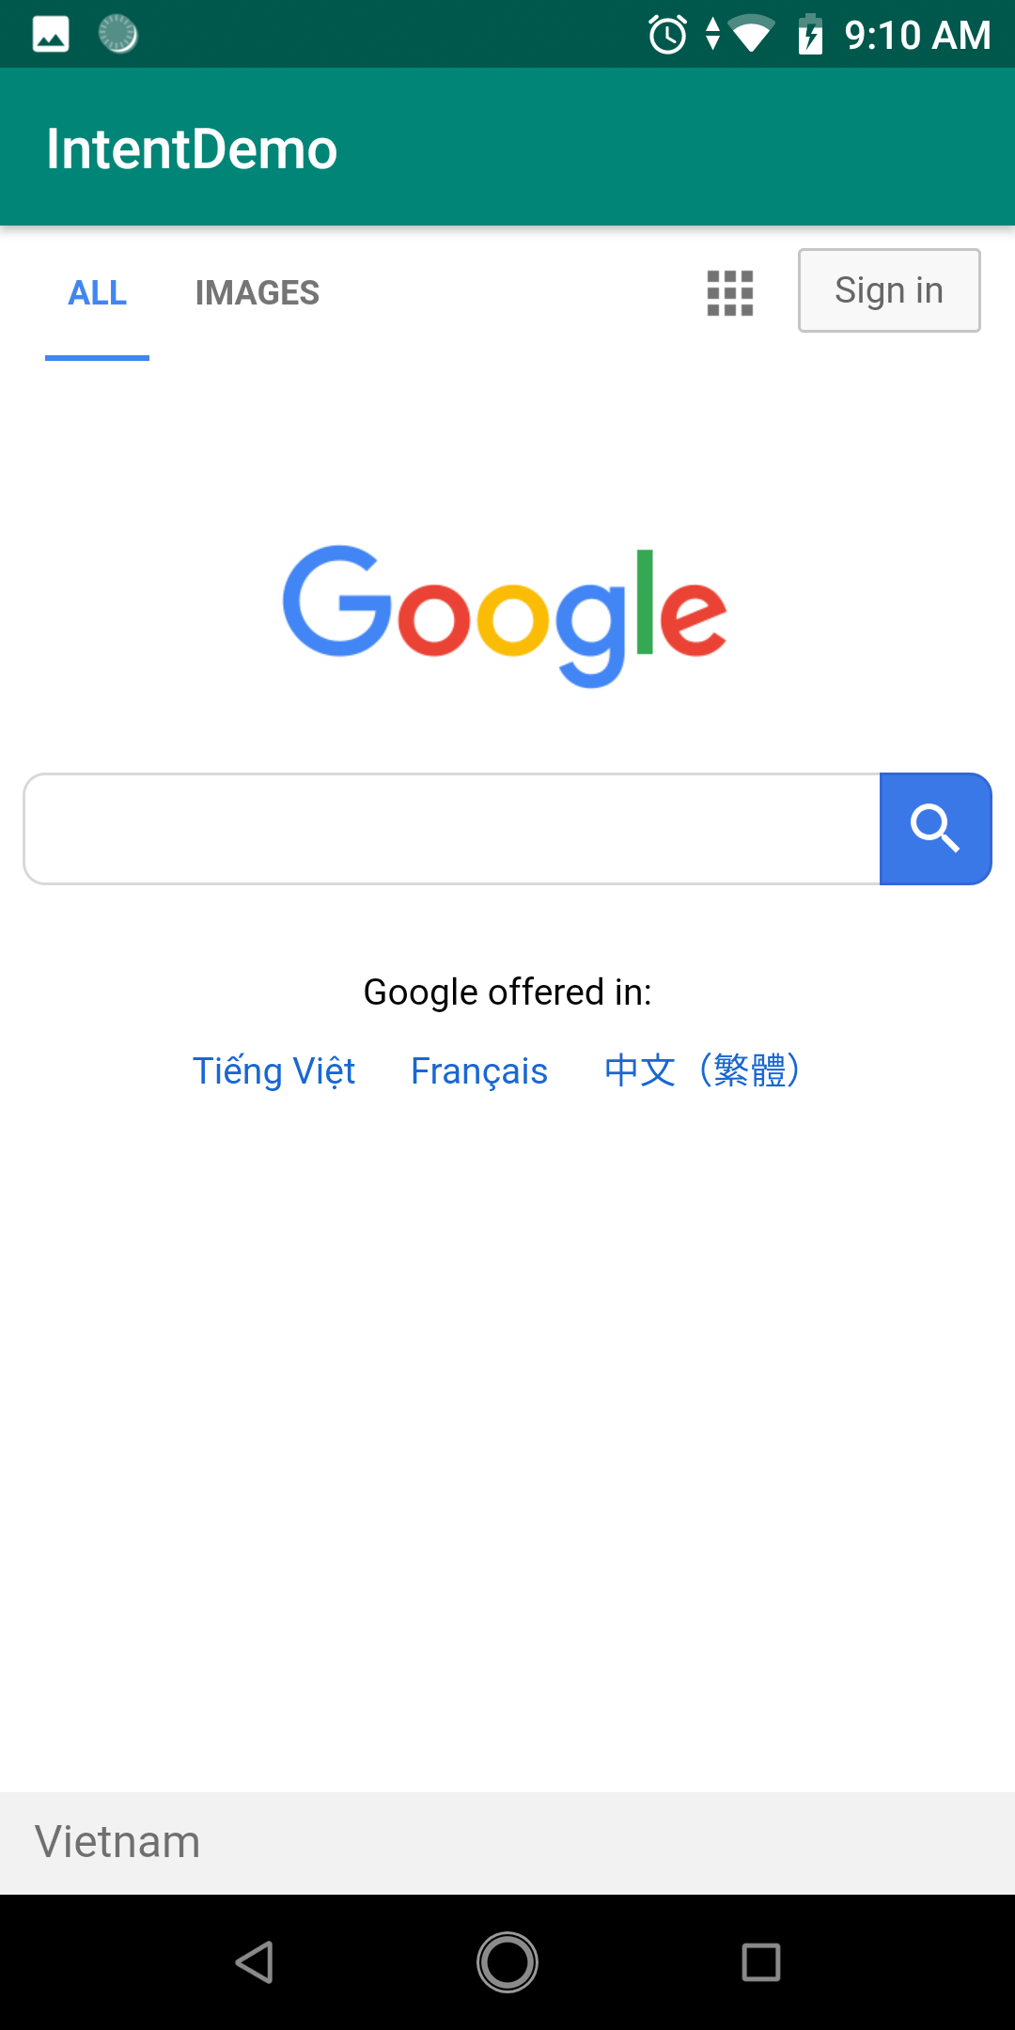
Implicit Intents
Testing application

Slide 20
Broadcast Intents and Broadcast Receivers
Overview of Broadcast Intents
Broadcast intents are Intent objects that are broadcast
Broadcast Limitations
https://developer.android.com/about/versions/oreo/background#broadcasts
Notes:
https://stackoverflow.com/questions/51221680/broadcast-receiver-not-working-in-android-oreo

Slide 21
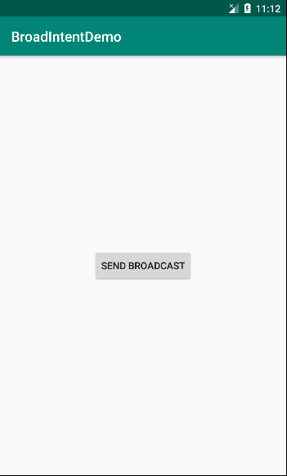
Broadcast Intents and Broadcast Receivers
The Broadcast Intent Example

Slide 22
Broadcast Intents and Broadcast Receivers
Creating and Sending the Broadcast Intent
public void onClick(View view) { Intent intent = new Intent(); intent.setAction("CUSTOM_BROADCAST_INTENT"); sendBroadcast(intent); }

Slide 23
Broadcast Intents and Broadcast Receivers
Creating the Broadcast Receiver
public class MyReceiver extends BroadcastReceiver { @Override public void onReceive(Context context, Intent intent) { // TODO: This method is called when the BroadcastReceiver is receiving // an Intent broadcast. Toast.makeText(context, "SOME_ACTION is received",Toast.LENGTH_SHORT).show(); } }

Slide 24
Broadcast Intents and Broadcast Receivers
Configuring a Broadcast Receiver in the Manifest File
<receiver android:name=".MyReceiver" android:enabled="true" android:exported="true"> <intent-filter> <action android:name="CUSTOM_BROADCAST_INTENT" > </action> </intent-filter> </receiver>

Slide 25
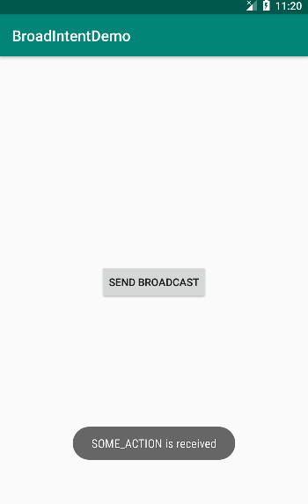
Broadcast Intents and Broadcast Receivers
Testing the Broadcast Example

Slide 26
Broadcast Intents and Broadcast Receivers
Listening for System Broadcasts
<receiver android:name=".MyReceiver" android:enabled="true" android:exported="true"> <intent-filter> <action android:name="CUSTOM_BROADCAST_INTENT" > </action> <action android:name="android.intent.action.ACTION_POWER_DISCONNECTED"> </action> </intent-filter> </receiver>

Slide 27
Broadcast Intents and Broadcast Receivers
Handle receiver
@Override public void onReceive(Context context, Intent intent) { // TODO: This method is called when the BroadcastReceiver is receiving // an Intent broadcast. String action =intent.getAction(); //Toast.makeText(context, action,Toast.LENGTH_SHORT).show(); if(action.equals("CUSTOM_BROADCAST_INTENT")) Toast.makeText(context, "SOME_ACTION is received",Toast.LENGTH_SHORT).show(); if(action.equals("android.intent.action.ACTION_POWER_DISCO NNECTED")) Toast.makeText(context, "ACTION_POWER_DISCONNECTED",Toast.LENGTH_SHORT).show(); }

Slide 28

End of Lesson 10

Slide 29
Thank you!

